Slide 1
Intro to Natural Language Processing - Project Delivery #3
150117060 Ahmet Hakan Şimşek
150116062 Muhammed Bera Koç

Slide 2
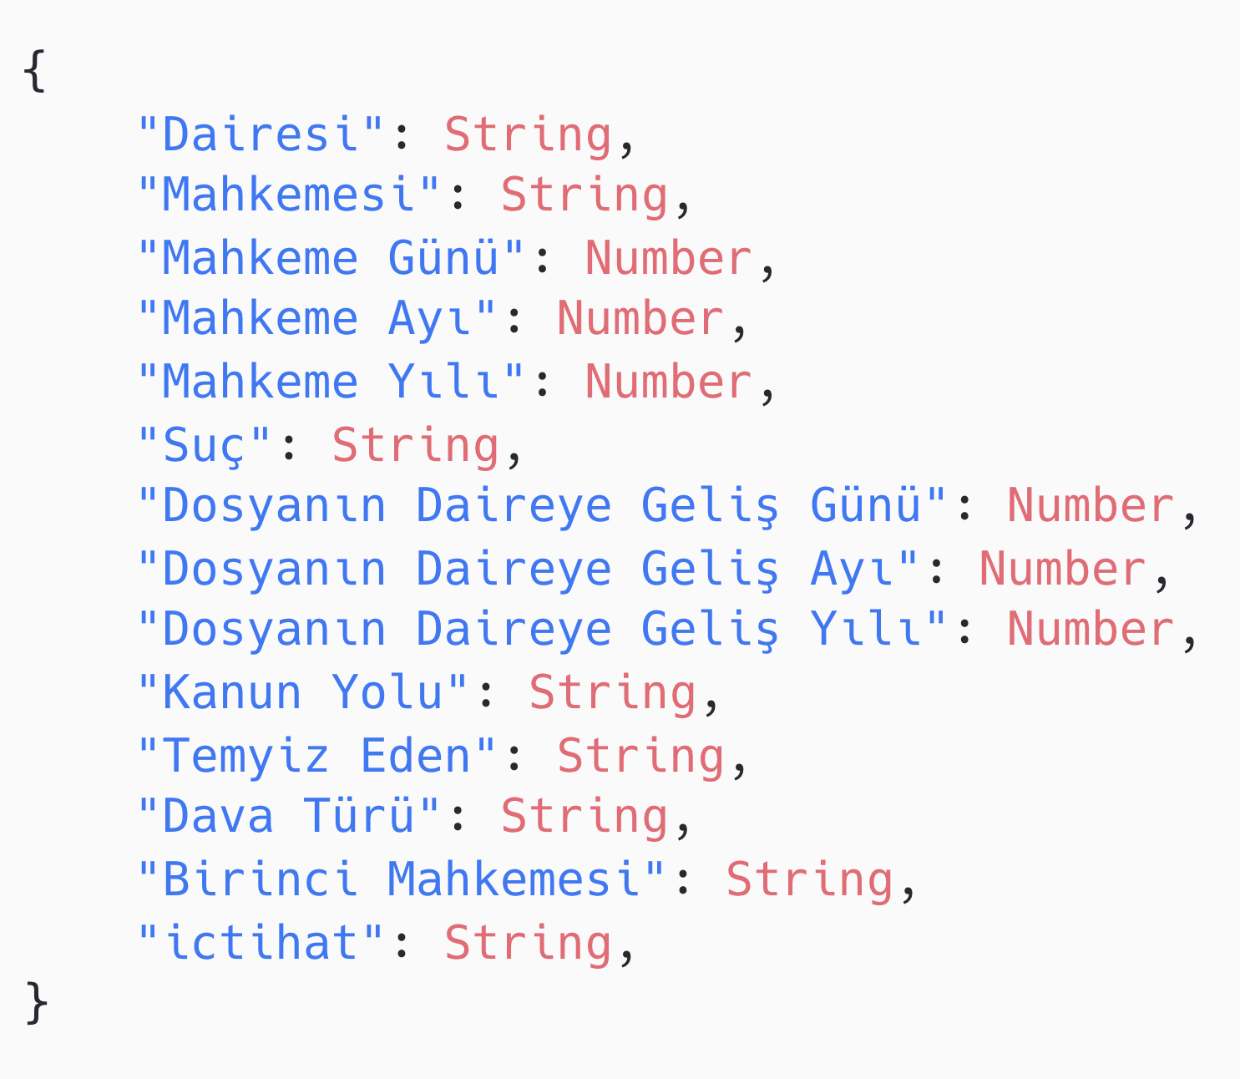
Dataset Description
We used the given dataset in the beginning of the semester in this lecture.
Dataset has 27842 instances
Each instance has 14
We only use two of them: ‘ictihat’ and ‘Suç’
We use ‘Suç’ for classification label and ‘ictihat’ for its features

Slide 3
Classification

Slide 4
Approaches/ Preprocessing
We build 2 different approach.
•1st one with Convolutional Neural Network(CNN).
•2nd one with Long Short-Term Memory Networks (LSTM).
We use MLP(ML Perceptron) for numerical, nominal attributes; main_category, country, usd_goal_real. We normalize numeric attributes, and encoding nominal, categorical attributes.
We use CNN, LSTM for text attribute like in our 1st approach.
And then we combine this two model.

Slide 5
Preprocessing Class Label for Classification
Our class label generated from “Suç” attribute.
In Suç attribute we have different labels:
◦”Kasten yaralama”, “Kişiyi hürriyetinden yoksun bırakma” , “Başkasına ait kimlik kartı kullanma” etc.
And we assign our class label 1 if state is “successful”, otherwise 0.

Slide 6
Preprocessing Textual Data for Word Embeddings
We use “fastText” as word embeddings. Vocabulary size for this model is more than 2.000.000 . The word vectors are trained on a corpus consist of 950 million words.

Slide 7
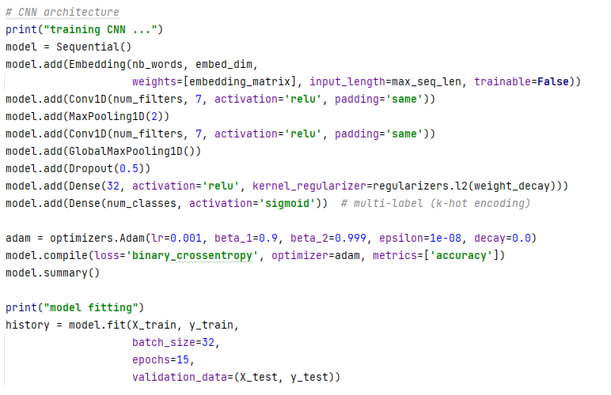
Outputs with Inputs – CNN

Slide 8
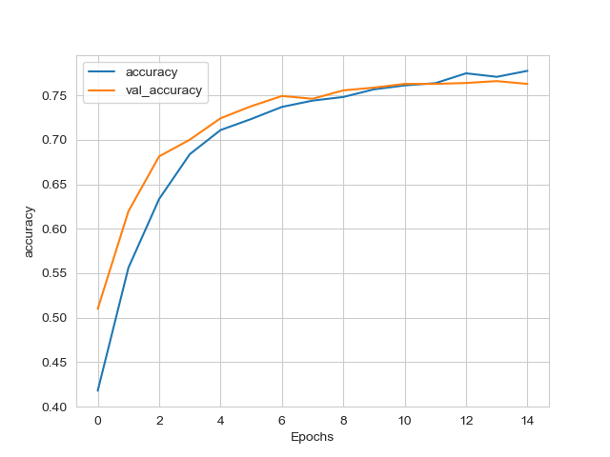
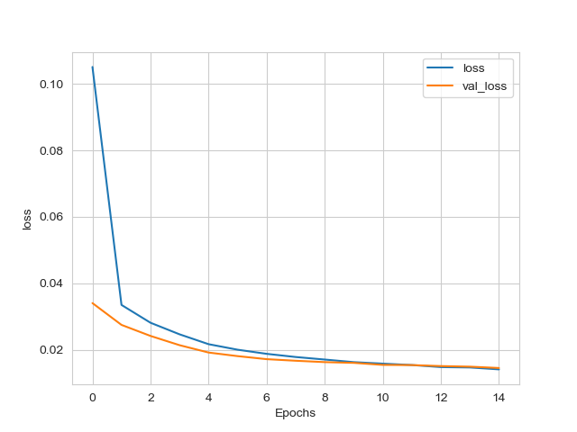
Results
110206ms
loss: 0.0142
accuracy: 0.7775
val_loss: 0.0146
val_accuracy: 0.7628

Slide 9
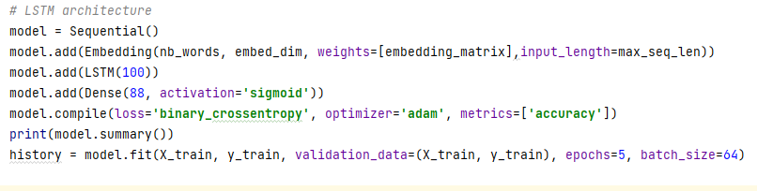
Outputs with Inputs – LSTM

Slide 10
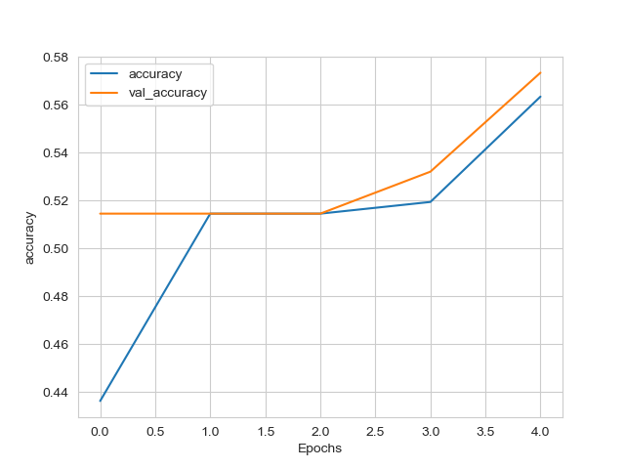
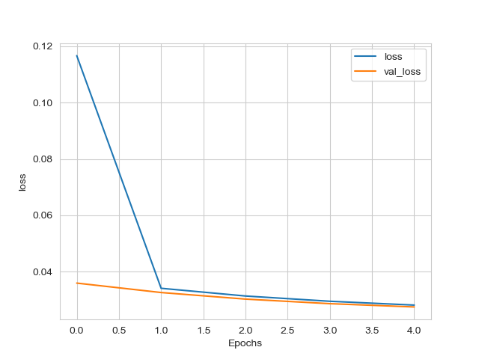
Results
236267ms
loss: 0.0281
accuracy: 0.5634
val_loss: 0.0275
val_accuracy: 0.5734

Slide 11
Conclusion
In CNN approach, we have very close accuracy values, but LSTM takes too much time.
In LSTM approach, we have worse accuracy with LSTM, and it took too much time here also.

